Slide 1
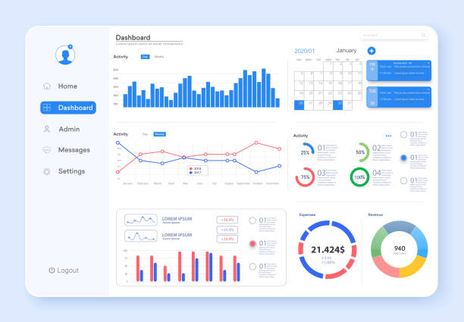
Superstore Sales Analysis
Driving Profitability Through Data
Business Analytics Department | October 2025

Slide 2


The Big Picture
Our analysis of 9,994 orders reveals 3 key opportunities to increase profitability
1
Discount strategies are causing significant losses
2
Product categories show dramatic profit differences
3
Regional performance gaps present growth opportunities
Our Analysis Approach
Data cleaning & preparation
Exploratory data analysis
Predictive modeling (R²: 0.85)

Slide 3
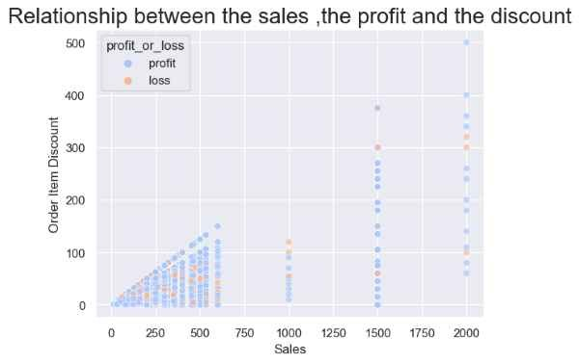



Finding #1: Discounts are Destroying Profit
Key Insight
Orders with >40% discount lose money 95% of the time
High discounts show strong negative correlation with profit
Orders with 20-40% discount have mixed profitability
Orders with 0-20% discount maintain healthy profit margins

Slide 4



Recommendation #1
Expected Impact
+35%
ACTION
Cap all discounts at 20%
Average profit margin increase on orders with previous discounts >20%
Increase profit margins on high-discount orders
Implementation Steps
Train sales team on value-based selling techniques
1
Update sales system to enforce 20% discount cap
Monitor profitability metrics for each discount level
2
Conduct value-based selling training workshops
3
Review all existing high-discount contracts

Slide 5
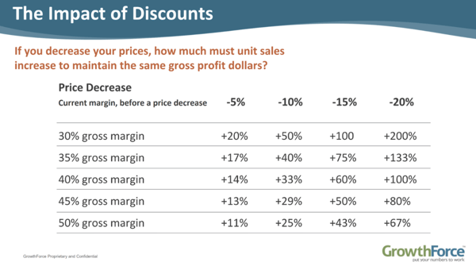



Finding #2: Not All Products are Equal
Key Insight
Technology drives profit, while Furniture drags it down
Technology category generates highest profit margins (25% average)
Office Supplies maintain steady profitability with high volume
Furniture category shows negative profitability, especially "Tables" sub-category
Technology
+85K
Office Supplies
+65K
Furniture
-30K

Slide 6




Recommendation #2
Promote Technology Products
Investigate Tables Sub-Category
1
Increase marketing spend for Technology category
1
Conduct cost analysis of Tables sub-category
2
Create sales incentives focused on high-margin tech items
2
Review shipping costs and logistics for bulky items
3
Analyze supplier pricing and negotiate better terms
3
Develop bundle offers with complementary tech products
Expected Impact
Technology category shows highest profit margins (25% average)
Urgency Level
Tables sub-category shows consistent negative profitability
+42%
Potential increase in overall profitability
-28%
Average loss margin on Tables products

Slide 7
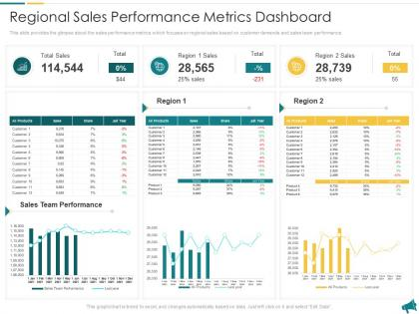
Finding #3: A Tale of Two Regions
Key Insight
West & East are thriving. Central & South are an untapped opportunity.
West region leads with highest profit margins (32% average)
East region shows strong performance with high volume sales
Performance Gap
Growth Potential
Central region has significant growth potential with existing customer base
3x
+45%
West region outperforms Central by 3x
Potential increase in Central region
South region shows lower penetration but higher average order value
West
+90K
East
+75K
Central
+45K
South
+30K

Slide 8




Recommendation #3
ACTION
West vs. Central: Key Differences
Replicate West's success in the Central region
Form Regional Task Force
Regional Sales Director
Data Analyst
Marketing Lead
Operations Manager
Expected Impact
1
Analyze successful strategies in West region
2
Identify key differentiators between regions
+45%
6 mo
3
Develop pilot program for Central region
Potential profit increase in Central region
Timeline for initial results
4
Implement monitoring system to track progress

Slide 9
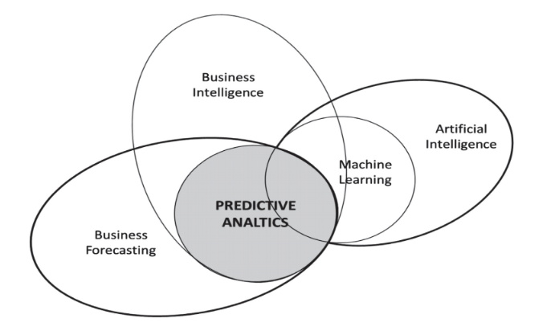




The Future: Predictive Power
Predictive Model Performance
Key Insight
We've built a model to predict profit, allowing us to stop losses before they happen
85%
92%
0.85
Random Forest algorithm trained on 9,994 orders
Accuracy
Precision
R² Score
Model achieves R² score of 0.85 on test data
Identifies key profit drivers and risk factors
Business Applications
Flag potentially unprofitable orders before shipping
Optimize pricing strategies for maximum profit
Identify high-value customers for targeted marketing

Slide 10




Summary & Next Steps
Our Recommendation
Approve these three initiatives to immediately improve profitability
1
2
3
Cap Discounts at 20%
Optimize Product Strategy
Replicate Regional Success
Implement company-wide policy limiting discounts to maximum 20%
Promote Technology products with increased marketing spend
Form task force to analyze West region strategies
Train sales team on value-based selling techniques
Investigate Tables sub-category to understand losses
Implement pilot program in Central region
Expected Impact
+35%
Profitability increase
These initiatives can increase overall profitability by up to 35% within 6 months

